Slide 1
Tree Shrew Primary Visual Cortex

Slide 2
Part 1: Orientation Tuning

Slide 3
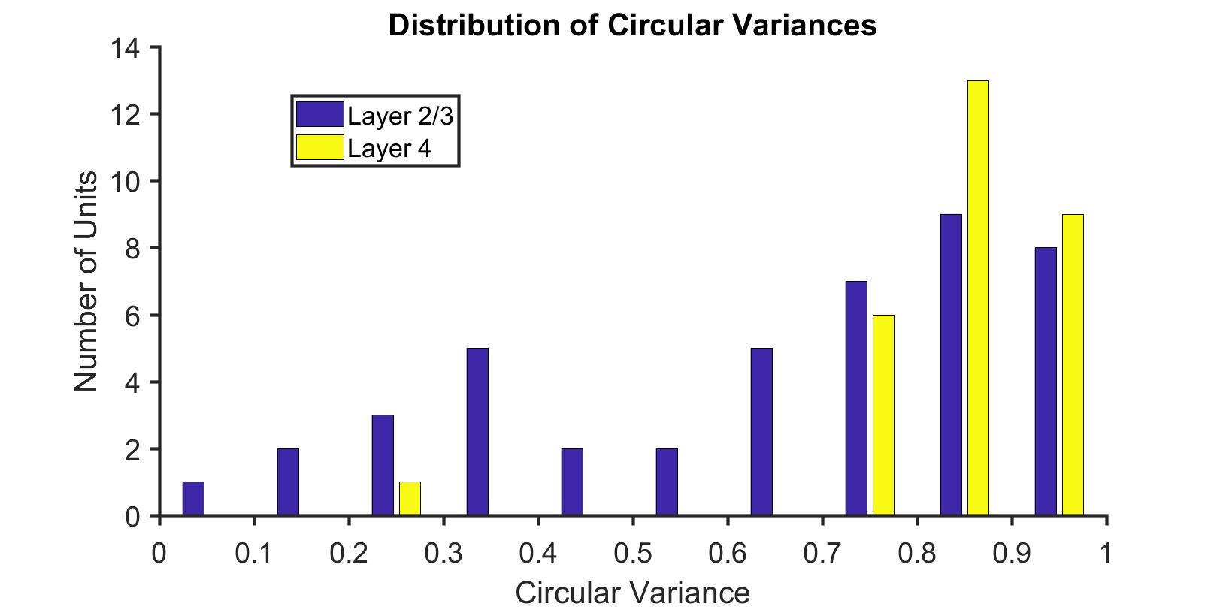
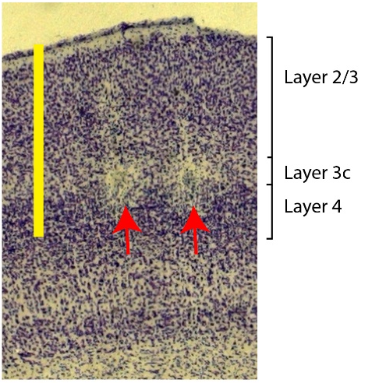
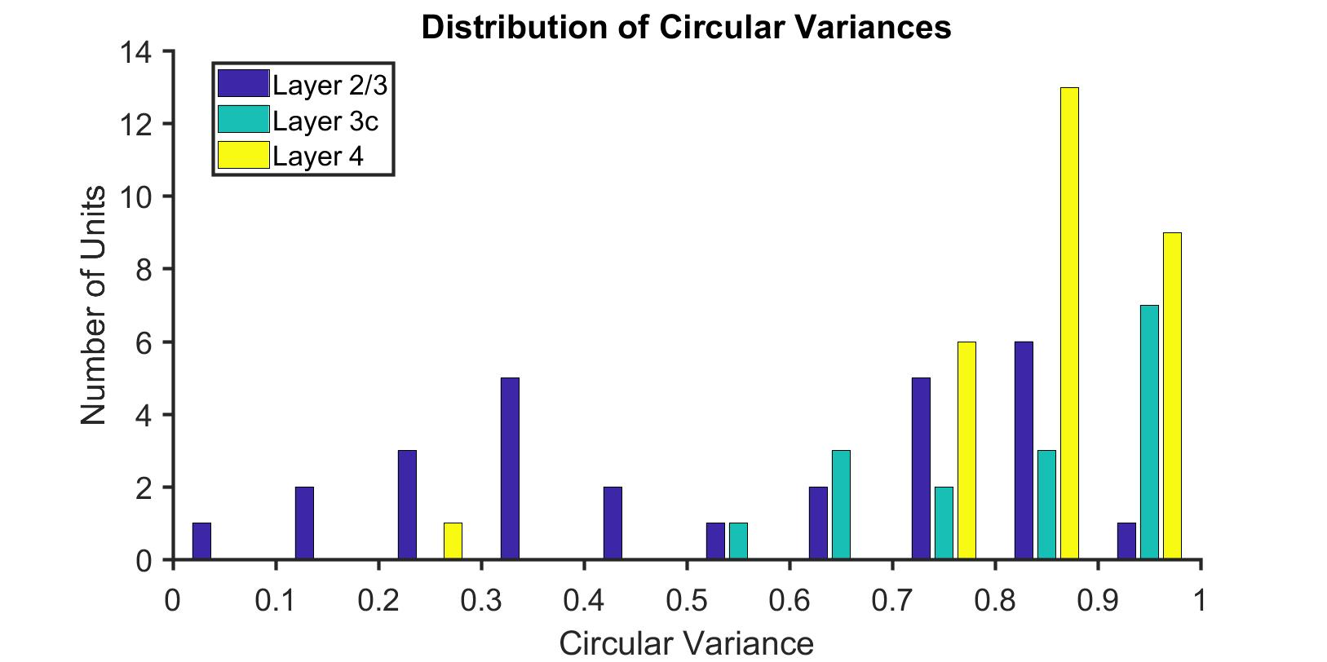
Histology

Slide 4
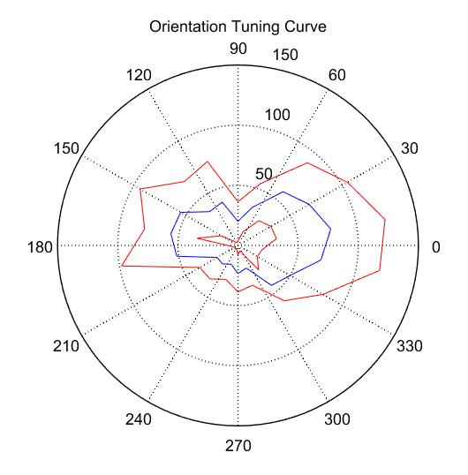
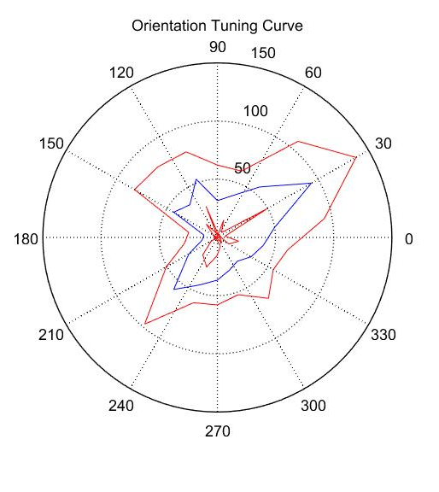
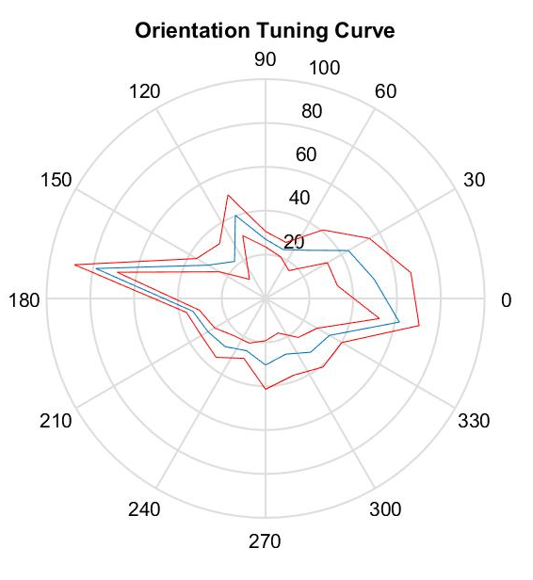
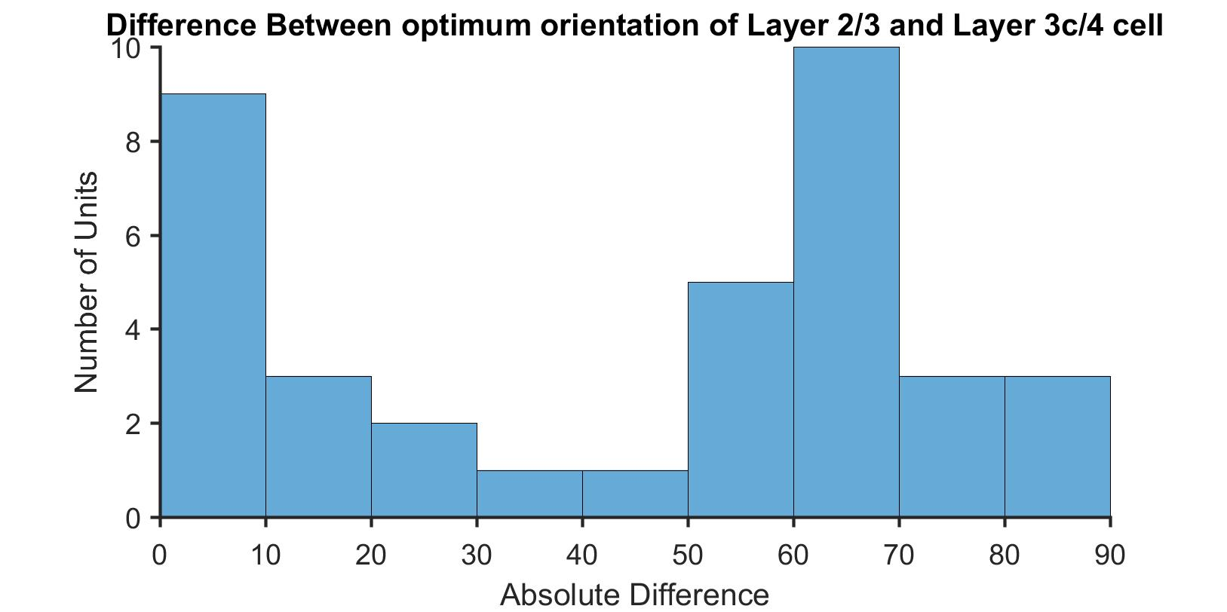
Layer 2/3
Layer 3c
Layer 4
Cm= -5.7º
Cm= 60.36º
Cm= 174.75º

Slide 5
Orientation selectivity within a column
Layer 2/3
Cm= -5.7º
Difference in orientation selectivity between layer 2/3 cell and the layer 3c/4 cell within a track
Layer 3c
Cm= 60.36º
N=37 pairs
Layer 4
Cm= 174.75º

Slide 6
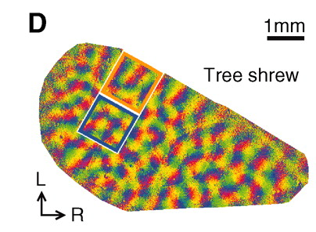
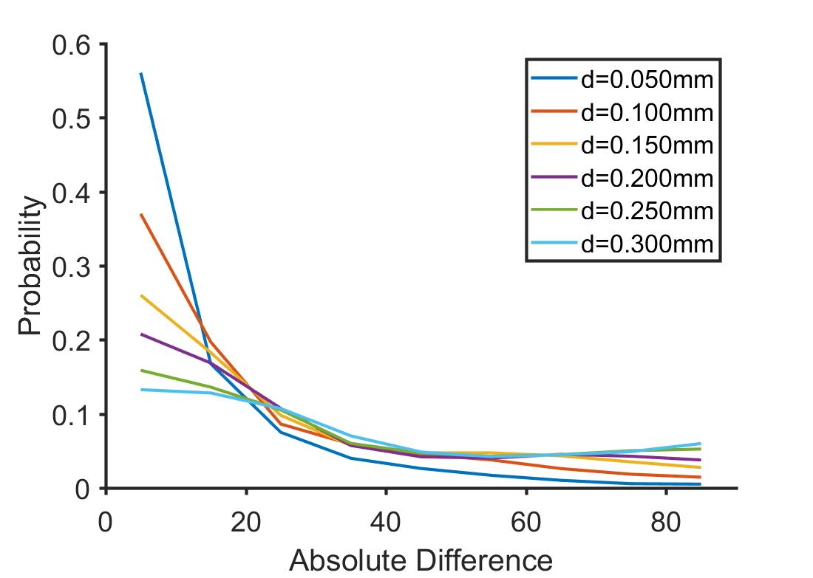
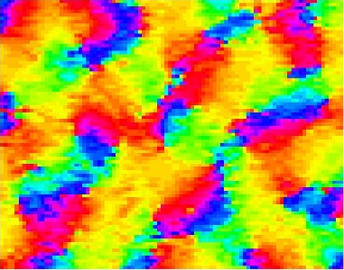
Orientation selectivity within a column
Probability of getting a peak at 65º
Highest at d=0.25; p=0.045
Lowest at d=0.05; p=0.01

Slide 7
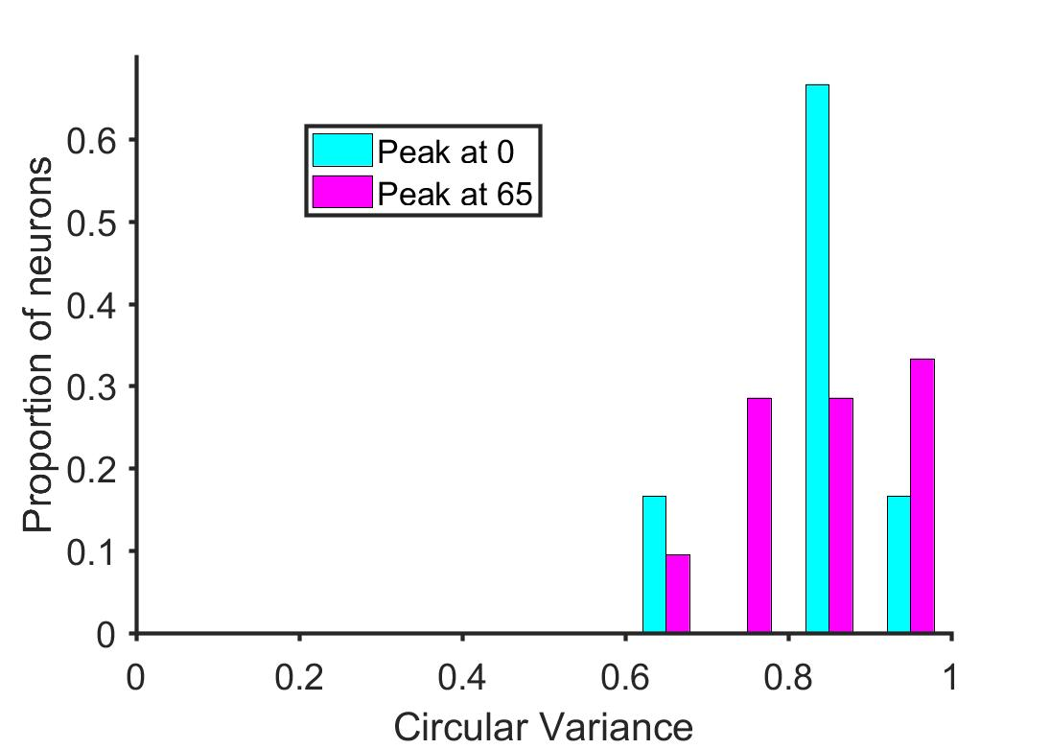
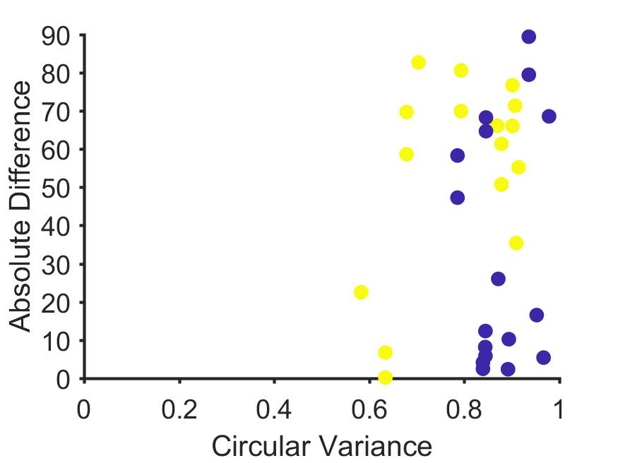
Orientation selectivity within a column- Circular Variance & Laminar Position
Kruskal-Wallis test, df=1,31, p=0.71
Notes:
2 peaks – 0+22.5; 65 +-22.5

Slide 8
Part 2: Spatial Frequency Tuning

Slide 9
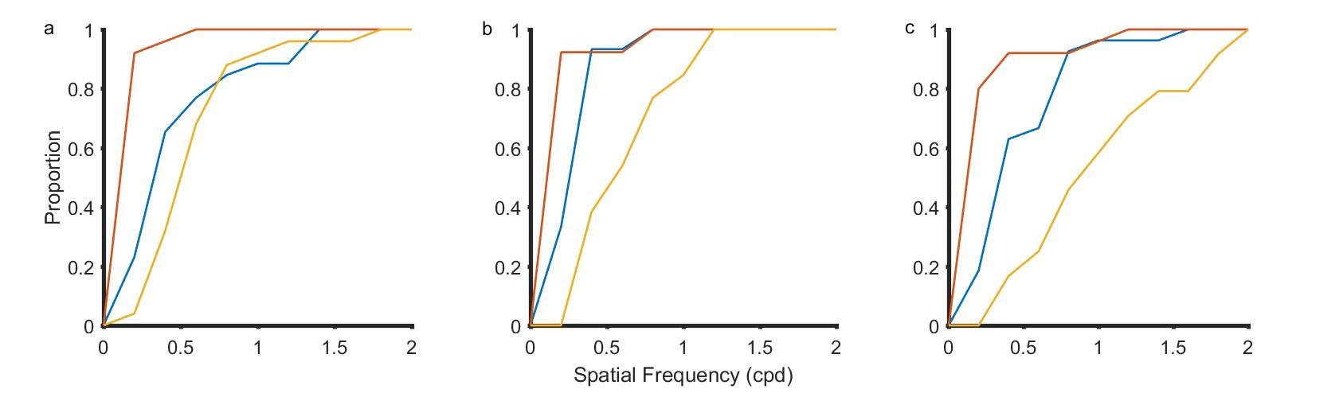
Spatial Frequency Tuning of neurons in different Lamina
Notes:
Layer 4, Layer 3c and Layer 2/3 cells

Slide 10
Part 3: Spatial Frequency and Orientation Tuning

Slide 11
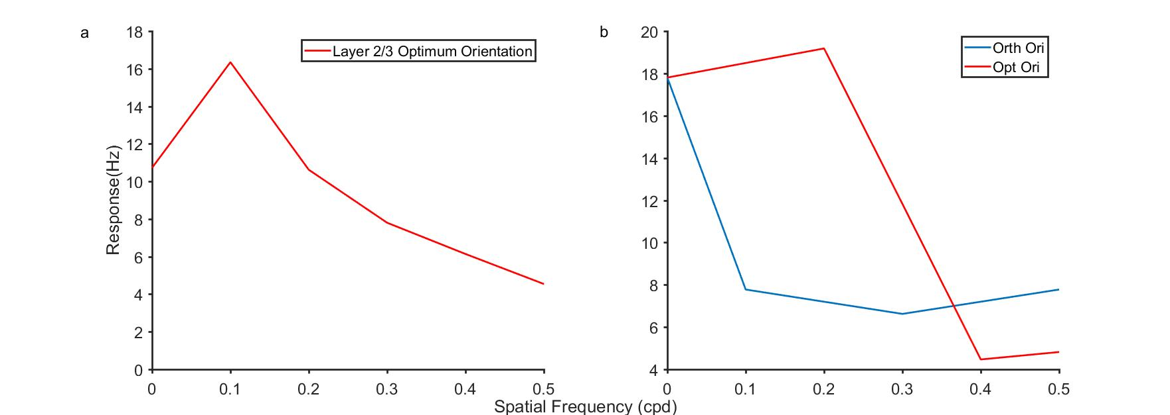
Spatial Frequency Tuning and orientation tuning (Layer 2/3 and input layer cells)

Slide 12
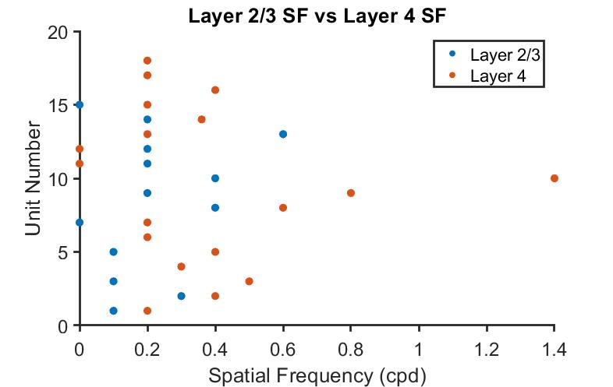
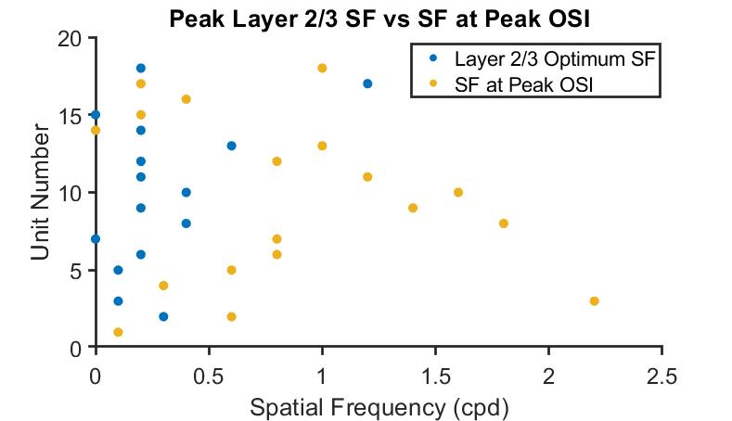
Doesn’t have the same effect as in cats and macaques

